Slide 1
Group 8
Thomas Smith, George Davis, Shane Stephenson

Slide 2
Logline - Learn Key stage 2 History through Archaeological Excavations
Demographic – 8 to 12

Slide 3
Key Stage 2 History Topics
Ancient Greece
Roman Empire
Ancient Egypt
The Americas
Pre Historic (Stonehenge)
Vikings
Middle Ages
Anglo Saxons

Slide 4
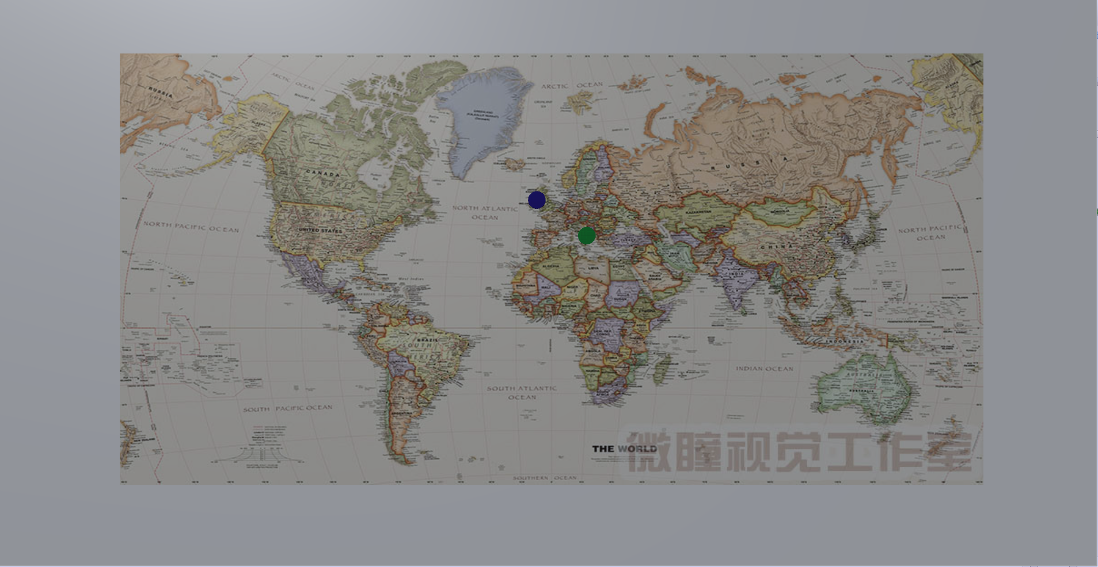
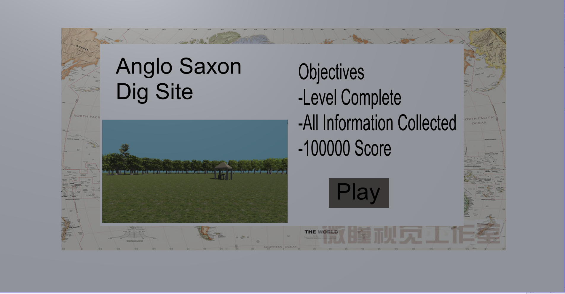
Level Select

Slide 5
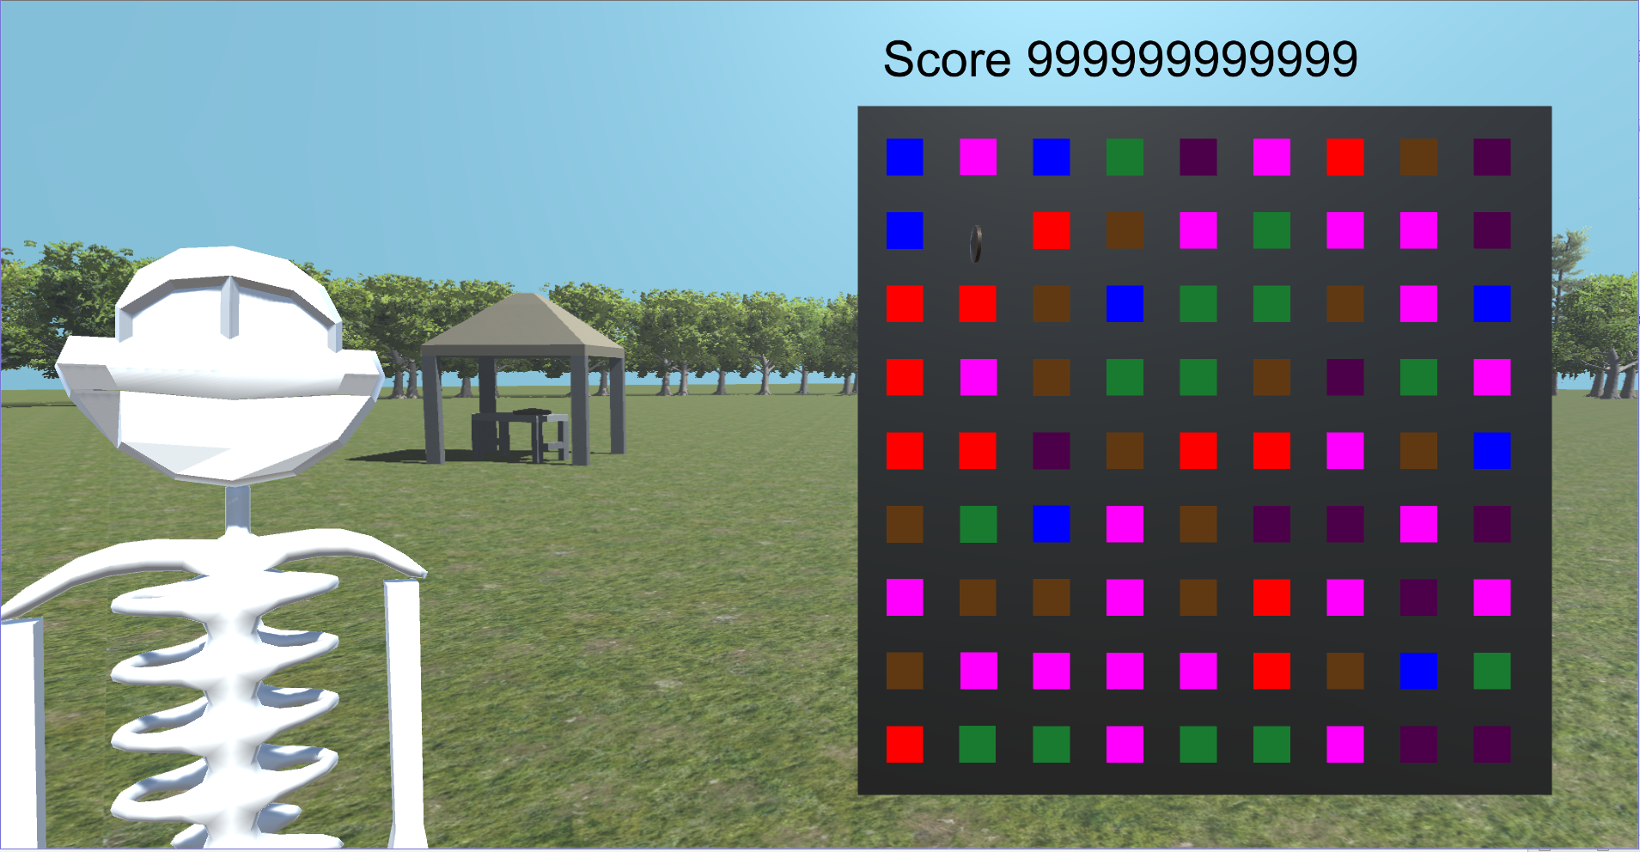
Matching mechanic

Slide 6
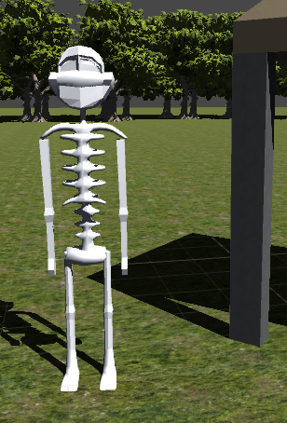
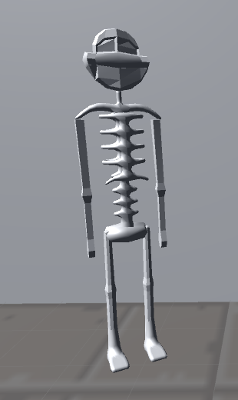

Slide 7
Game

Slide 8
Questions

